Slide 1
INSGIHTS & RECOMMENDATIONS FOR CREDIT CARD FRAUD DETECTION - Ashni Damaria

Slide 2
Agenda
Objective
Background
Data Methodology
Model Building & Evaluation
Recommendations
Appendix:
Data Sources
Assumptions

Slide 3
Objective
Root cause analysis & building machine learning models for early detection of fraudulent activities
Understanding financial implications of using machine learning model
Determining important features which lead to a very high probability of the transaction being fraud

Slide 4
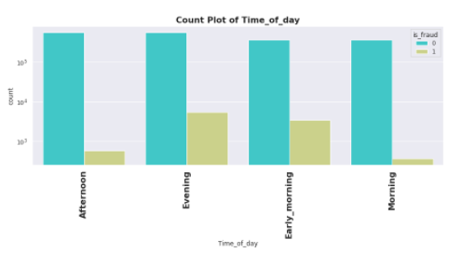
Background
Company has observed significant large no. of unauthorised transactions, causing huge revenue and profitability crisis
Such activities have been reported during non-peak and odd hours of the day leaving no room for suspicion
Long-term solution – build a fraud detection system using various ML algorithms

Slide 5
Exploratory Data Analysis
Checking basics
Transition columns
Drop unnecessary columns
Drop duplicates
Data checks
Power transform
Skewness check
ADASYN & class weight
Data imbalance check
Missing value check
Visualizations

Slide 6
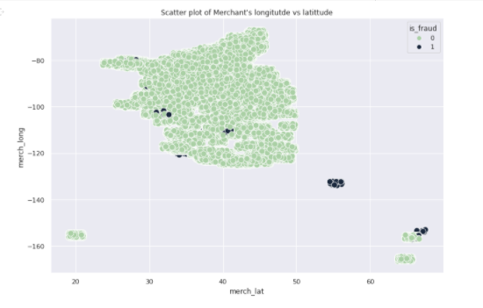
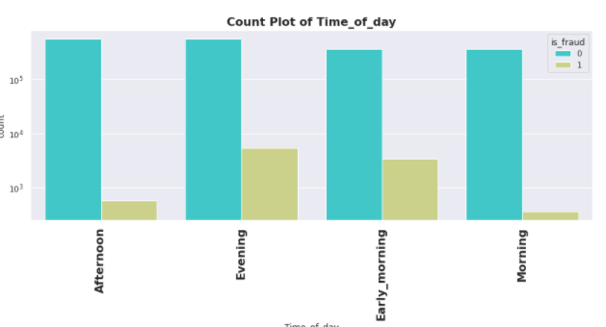
Findings Of EDA
The occurrence of fraudulent transactions increases:
During early morning & evening hours
While shopping & grocery transactions
Despite less transactions over week days, frequency of frauds is high
One set of frauds that are happening have completely different latitudes & longitudes
This can become an important factor to predict fraudulent transactions

Slide 7
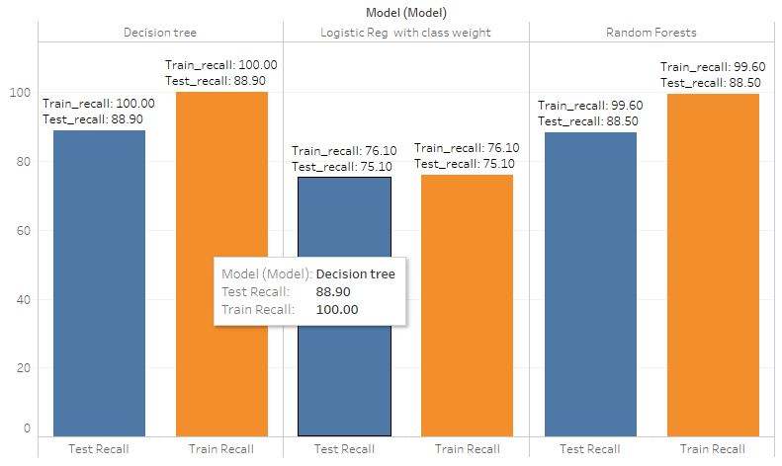
Best Model: Decision Tree
Three models were built: Logistic (Linear), Decision Trees & Random Forests.
Area under curve (AUC) score & recall metric were considered while choosing the best model
Decision Trees & Random forests are at par with each other with DT’s out performing RF’s by 0.40%

Slide 8
4,26,783$
1,73,287$
> 40%
Financial Implications: Massive Savings
Before Model Building
After Model Building
Savings!

Slide 9
Key Factors
Features that play a major role in detecting fraud transactions:
Amount of transaction
Geography locations
Merchant’s latitude & longitude
Customer’s latitude & longitude

Slide 10

Appendix – Data Sources
Data set from Kaggle link.
https://www.kaggle.com/kartik2112/fraud-detection
Detailed supporting document for analysis & model building
Python file
Cost Benefit analysis
Excel file

Slide 11

Appendix- Assumptions
12am – 6am is considered as early morning, 6am to 12 pm as morning, 12pm to 4pm as afternoon and 4pm to 12am as evening
From latitudes & longitudes, street, city & zip codes can be recovered
Credit cards having length in between 10 -19 digits are valid

Slide 12
THANK YOU!

